Slide 1
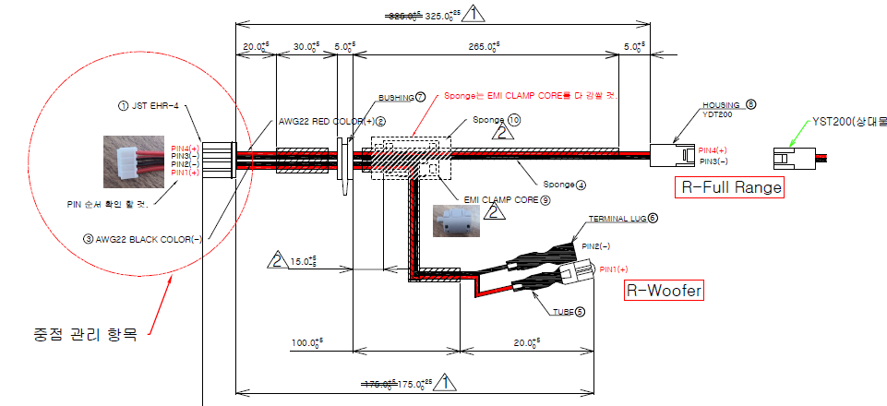
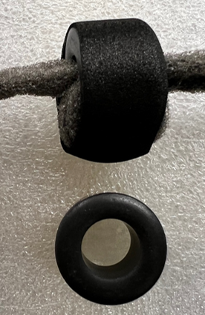
210906_SPEC_4AI20-CMXX05_REV03
265mm -> 295mm
15mm +/-5mm

Slide 2
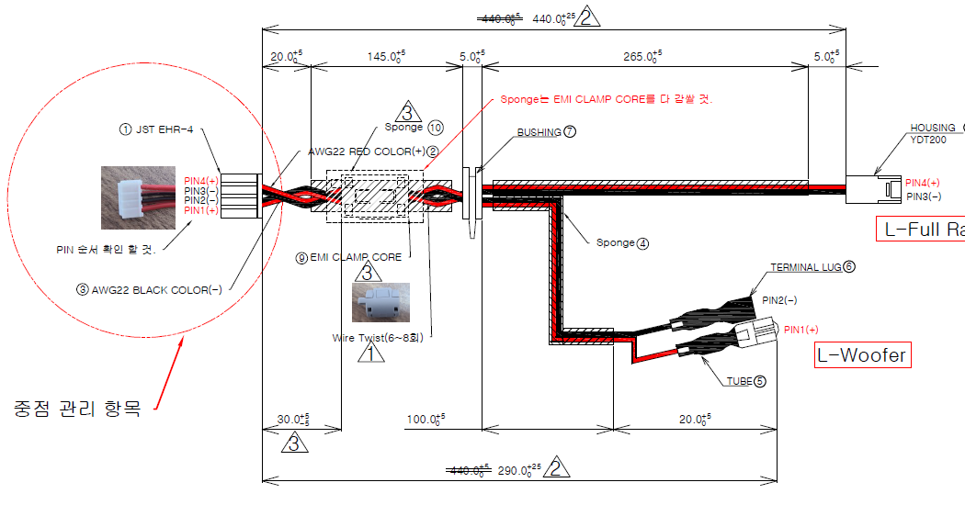
210906_SPEC_4AI20-CMXX04_REV04
145mm -> 175mm
Twist 사양삭제
30mm +/-5mm

Slide 3
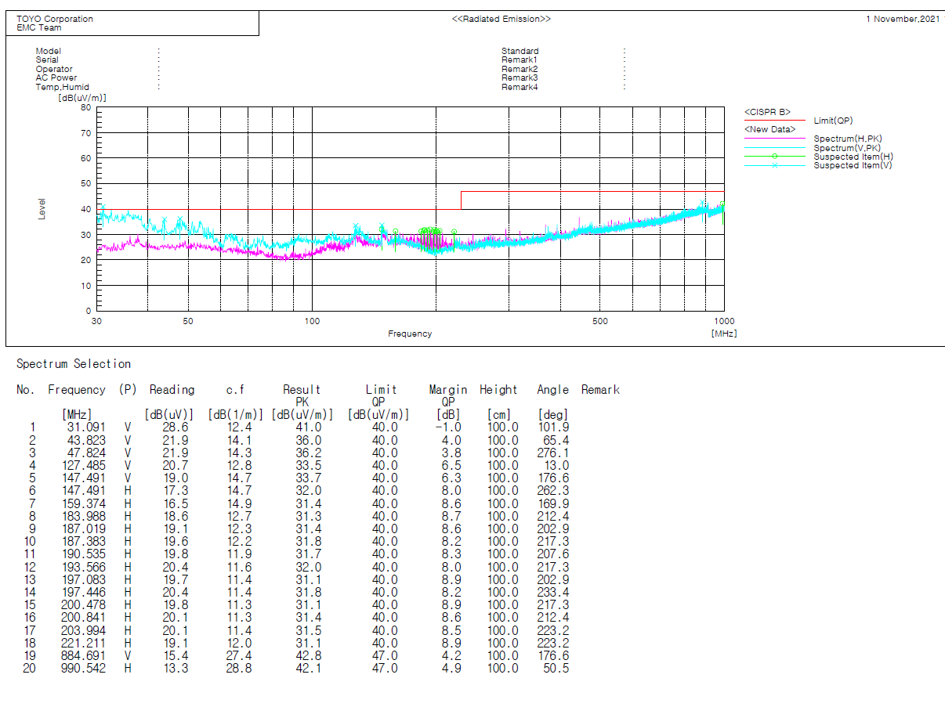
SPK cable spec (원통형 ferrite core Feelux OP 18(C)) EMI test result

Slide 4

Feelux OP 18(C)data sheet

